Slide 1
MANAGING LARGE CLASSES
Revised Lower Secondary Curriculum
December 2022

Slide 2
Session Outcomes
By the end of this session, participants;
Explore the concept of large classes in competency-based education
Elicit hands-on strategies of managing large classes in competency-based education

Slide 3
Subject Group Activity
What is a large class in the context of Competency-Based Curriculum?

Slide 4
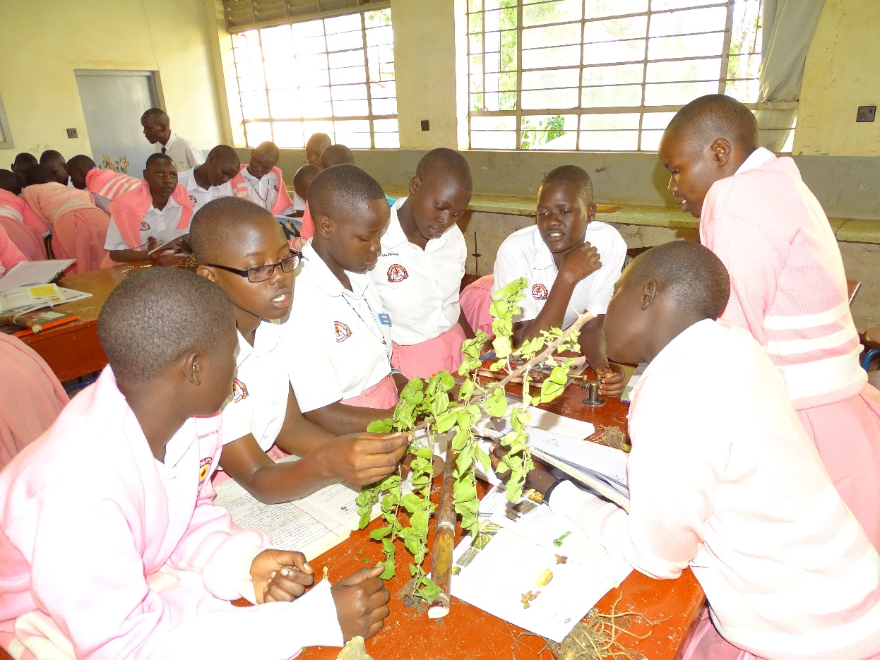
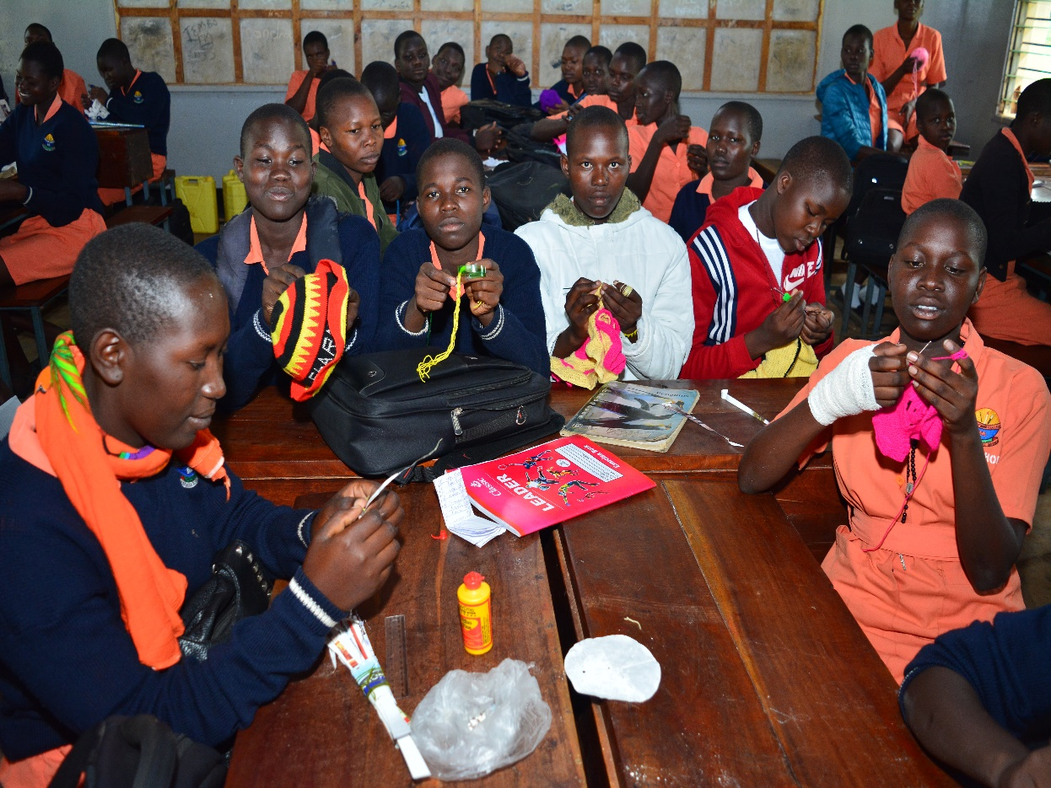
Subject Group Activity Would you consider the classes below to be large and well-managed? Give reasons for your answer.

Slide 5
Subject Group Activity
How do you ensure that learning outcomes are achieved during the lessons?
Notes:
Challenges
-Time consuming; exhausting, demotivates teachers, group formation is difficult, supervision of the task assigned is difficult; achieving expected learning outcomes is difficult; assessment is difficult; difficult to cater for individual differences;
Strategies for managing large classes in CBE
-Promote learner-centred teaching (learner-led activities, team assignments); become acquainted with as many students as possible; have a seating chart; enter the class early to arrange it; monitor individual groups; arrange to meet group of students after class, use small groups, encourage brainstorming, think-pair share, group presentations, leaving the class on time
Teaching methods
Student-led seminars, team assignments, brainstorming, audiovisual method; having guest speakers etc.

Slide 6

.
.

